Slide 1

Animal models of complex diseases part 1
The developmental basis of disease
Dr Will Norton
whjn1@le.ac.uk

Slide 2
Developmental basis of disease
Embryonic development is a time
when the brain is very plastic and
alters rapidly
Small changes (in neurotransmitter
type, wiring etc) can lead to
dramatic phenotypes
Notes:
Could explain a bit about my background and why I wanted to study this

Slide 3
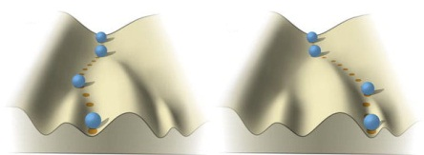
From alterations in neural development to disease
Most mutations are non-lethal and will cause subtle changes to embryonic development / brain wiring: “developmental disconnection”
In some cases developmental alterations can lead to psychiatric disorders – diseases that affect all aspects of emotion, thought and social interactions
Mitchell 2011, after Waddington
Notes:
Diagramme shows random changes or choice points that occur during embryonic development that can lead to wide-ranging differences

Slide 4

Developmental basis of disease
Small effects amplify over time –
like a snowball rolling down a hill
Jan Buitelaar

Slide 5
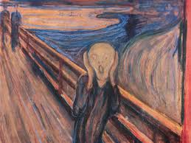
Psychiatric disorders
Psychiatric disorders are complex diseases that affect many aspects of mental function
including thinking, feeling, mood and sociability
Leading cause of disability in Europe and North America
Available drug therapies are often only palliative with variable efficacy and side-effects
Many compounds discovered serendipitously 50 years and not been improved since
Need to better understand underlying neurobiology and genetics of psychiatric disorders

Slide 6

Diagnosing gastrointestinal disease
If you go to the doctor with chronic abdominal distress, the physician will perform several tests:
Check inflammatory markers, test for allergies, perform a colonoscopy, take biopsies, measure enzyme levels
They may diagnose coeliac disease, Crohn’s disease, colon cancer…
If they cannot make a diagnosis they will name it irritable bowel syndrome:
a diagnosis of exclusion that does not give insight into the underlying cause

Slide 7

Diagnosing psychiatric disorders
Diagnosing psychiatric disorders are similar: physicians can compare symptoms
but do not understand how they are triggered.
Most PDs (schizophrenia, Alzheimer’s disease, autism spectrum disorder) are umbrella
terms for related disease with common symptoms
no evidence that underlying aetiology is the same
will not respond to the same treatment options

Slide 8
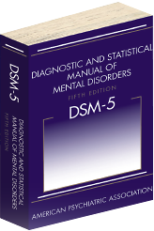
Diagnosis based upon behavioural symptoms
Diagnosis can be very subjective
Diagnosis can be controversial
In some cases want parents push for the diagnosis of a
disorder in their children
Insights into genetics / neurobiology could improve diagnosis:
Compare patients with same molecular lesion for example
Notes:
Are basically not fit for purpose. So we need better defined classes for each disease. Could compared “amygdala lesion PD” for example

Slide 9
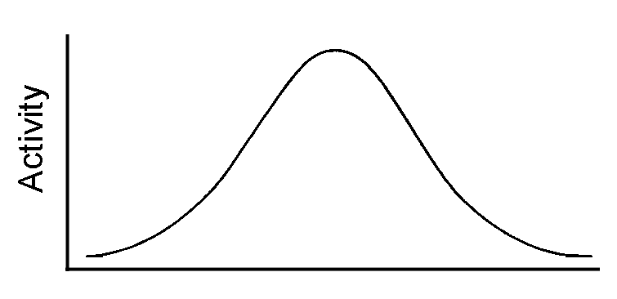
Psychiatric disorders are a spectrum
Often diagnosed on the basis of behavioural symptoms:
Few genetic or biological markers available
Large spectrum of symptoms can be observed
No. of people
ADHD
Activity
Notes:
Not always bad to have ADHD! Symptoms appear as a spectrum – how to talk about this? Can also be controversial

Slide 10
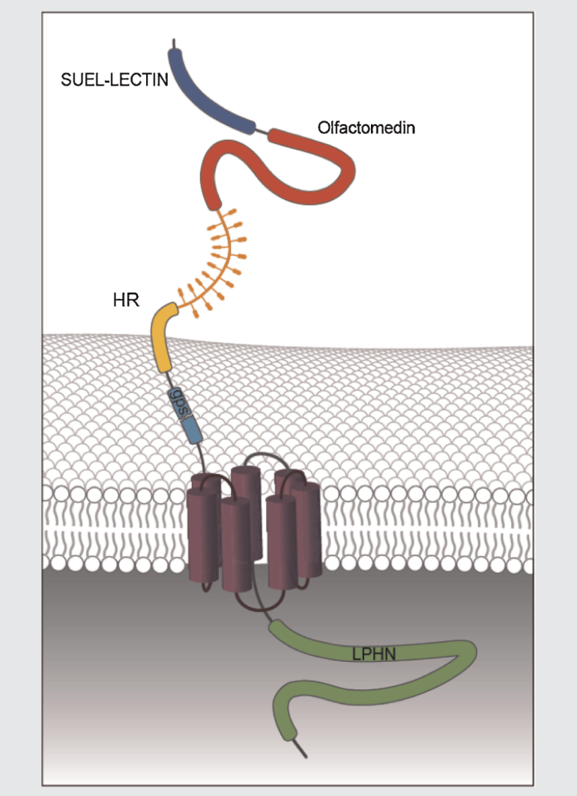
Psychiatric disorders are based upon cultural norms
Mutations in LATROPHILIN3 can lead to ADHD
Disease-causing mutations are ancestral (found in
distantly related species):
ADHD-like symptoms (hyperactivity, impulsivity)
would have been advantageous (or neutral) during
evolution
G x E interactions are very important
Children with mutations in LATROPHILIN3 raised in an
impoverished environment show non-ADHD behaviour;
those raised in an enriched environment have a greater
chance of suffering from ADHD
(LPHN3 not important in impoverished environments)
Choudhry et al., 2012; Domene et al., 2011
Notes:
Maternal smoking; drug or alcohol abuse; family trauma

Slide 11

Introduction to psychiatric genetics
“A ballet that is choreographed over time between the action of multiple genes,
environment and epigenetic factors” Gottesman and Gould, 2003
The common disease, common variant hypothesis (CDCV)
The inheritance of one mutation alone is not enough to cause a disease, but when
combined with others a theoretical threshold will be passed and the disease triggered
The common disease, rare variant hypothesis (CDRV)
A single mutation can trigger the disease, but this only occurs in rare cases
Or a mixture of common and rare variants…

Slide 12
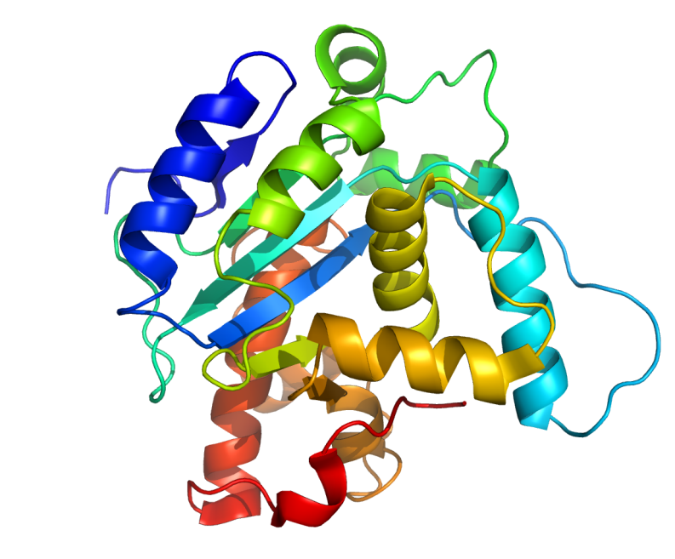
Introduction to psychiatric genetics
Rare mutations can be de novo – on average there are about 74 novel mutations
per genome in each generation, and more mutations occur in psychiatric disease
families
Mutations can be SNPs (single nucleotide polymorphisms / changes), can be insertions
or deletions or copy number variations (multiple genes affected)
Mutations can alter gene function in several ways:
Activate proteins
Reduce protein activity
Create abnormal biochemical functions
Notes:
Difficult to study novel mutations because you have to find them first!

Slide 13
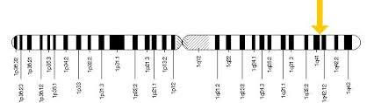
Introduction to psychiatric genetics
Different mutations in the same gene can cause a wide range of diseases:
common genetic basis of many diseases?
DISC1: schizophrenia, bipolar disorder, major depressive disorder, autism…
More than one mutation may be needed to trigger disease:
cf “Knudsen’s two-hit hypothesis” of cancer
Some mutations may alter susceptibility to psychiatric disorders; other may
increase disease penetrance.

Slide 14
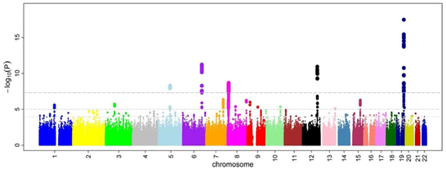
Genome wide association studies
Genome wide association studies (GWAS): relies upon identifying a statistical association
between a phenotype of interest (ADHD) and a panel of genetic markers (SNPs)
- Challenge to identify biological meaning of such “hits”
Translation of data to patients is still in its infancy
Statistical information is usually spatially close to a gene, not directly on it
Notes:
So bioinformatics is needed to identify the gene which is altered

Slide 15
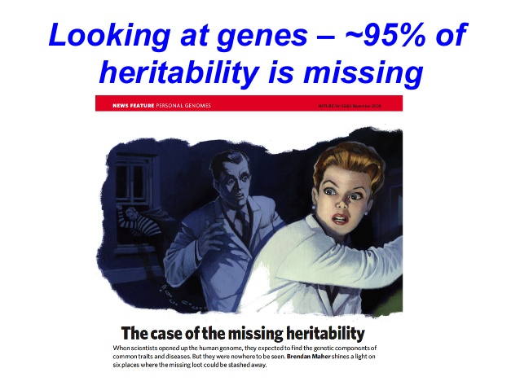
Missing heritability
Missing heritability – the number of genes identified as being important for
psychiatric disorders does not explain their genetic basis: “missing heritability”
Contribution of environmental factors
Few methods to identify genes
Multiple mutations in known-
rather than novel genes

Slide 16

Summary
Small changes during embryonic development can lead to long-lasting phenotypes
such as psychiatric disorders
Psychiatric disorders are caused by the combined effect of mutations in multiple
genes. When mutation burden passes a certain threshold then disease is triggered
The environment plays an important role as well – modified expression of
phenotypes
Statistical approaches such as GWAS can be used to identify genes which may
trigger disease

